Slide 1
Unit 12 Capacitors
Part C: Analysing Capacitors in Series and Parallel Connections

Slide 2
What will you learn?
Analyse series capacitor circuits.
Analyse parallel capacitor circuits.

Slide 3
Capacitors Connected In Series
C₁
C₂
C₃
C_{n}
I
I
I
I
V_{S}
+
−
Like in all series circuits, charging current I is same for all capacitors in the above circuit.
Since Q = I × t ⇒ All capacitors store same amount of charge.
Hence

Slide 4





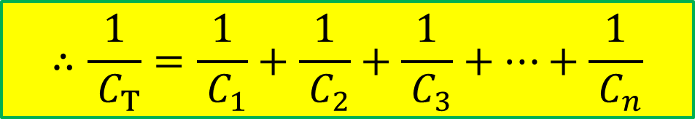

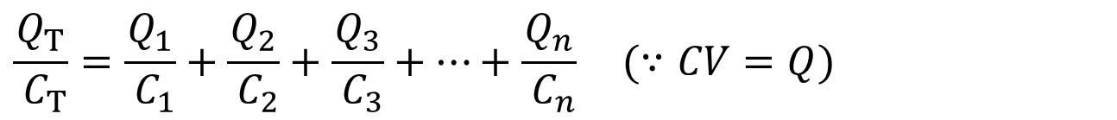
Capacitors Connected In Series
C₁
C₂
C₃
C_{n}
$$+ V_{1} −$$
$$+ V_{2} −$$
$$+ V_{3} −$$
$$+ V_{n} −$$
+
−
$$V_{S}=V_{T}$$
$$V_{T}=V_{1}+V_{2}+V_{3}+⋯{+V}_{n}=V_{S} (∵KVL)$$
$$\frac{Q_{T}}{ C_{T}}=\frac{Q_{1}}{ C_{1}}+\frac{Q_{2}}{ C_{2}}+\frac{Q_{3}}{ C_{3}}+⋯+\frac{Q_{n}}{ C_{n}} (∵CV=Q)$$
$$Q_{T}=Q_{1}=Q_{2}=Q_{3}=⋯=Q_{n}$$
$$∴\frac{1}{ C_{T}}=\frac{1}{ C_{1}}+\frac{1}{ C_{2}}+\frac{1}{ C_{3}}+⋯+\frac{1}{ C_{n}}$$

Slide 5
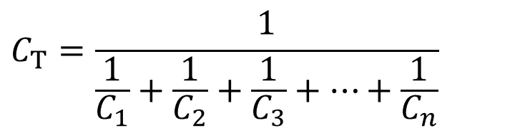
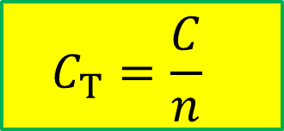
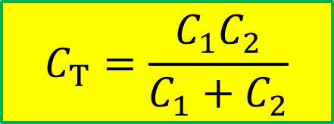
Capacitors Connected In Series
Total Series Capacitance
$$C_{T}=\frac{1}{\frac{1}{C_{1}}+\frac{1}{C_{2}}+\frac{1}{C_{3}}+⋯+\frac{1}{C_{n}}}$$
$$C_{T}=\frac{C_{1}C_{2}}{C_{1}+C_{2}}$$
2 capacitors in series
$$C_{T}=\frac{C}{n}$$
Capacitors of equal values
Total series capacitance is always less than the smallest capacitance.

Slide 6
Capacitors Connected In Series
EXAMPLE
Determine the total capacitance between points A and B.

Slide 7
Capacitors Connected In Series
Example
Find the total capacitance, C_{T.}

Slide 8
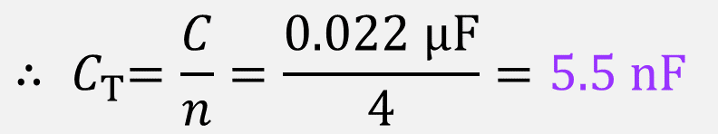
Capacitors Connected In Series
Example
Determine C_{T} for the series capacitors.
C₁
0.022μF
C₂
0.022μF
V_{S}
C₃
0.022μF
C₄
0.022μF
∵ All the capacitors connected in series are of the same value.
$${∴ C}_{T}=\frac{C}{n}=\frac{0.022 μF}{4}=5.5 nF$$

Slide 9
Capacitor Voltages
+
C₁
V₁
Capacitors connected in series acts as a voltage divider.
−
+
C₂
V₂
Q₁ = Q_{T}
V_{T}
−
+
C₃
V₃
C₁V₁ = C_{T} V_{T}
−
General Expression
for any one capacitor.
Largest-value capacitor has smallest voltage.
Smallest-value capacitor has largest voltage.

Slide 10
Capacitor Voltages
C₁
C₂
C₃
Example
Find the voltage across each capacitor.
0.1 μF
0.47 μF
0.22 μF
V_{T}
25 V
25 V
First find C_{T}

Slide 11
Capacitor Voltages
C₁
C₂
C₃
Then using general formula find V_{x}:
0.1 μF
0.47 μF
0.22 μF
V_{T}
25 V

Slide 12

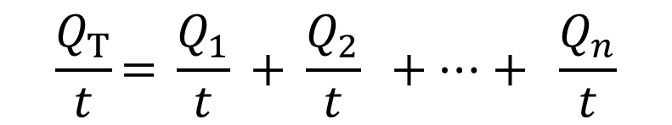
Capacitors Connected In Parallel
I_{T}
+
I₁
I₂
I₃
I_{n}
V_{T}
−
C₁
C₂
C₃
C_{n}
By KCL,
C_{T}V_{T} = C₁V₁ + C₂V₂ + ⋯ + C_{n}V_{n}
I_{T} = I₁ + I₂ + ⋯ + I_{n}
For parallel circuit,
Q = I × t, and t is common.
V_{T} = V₁ = V₂ = ⋯ = V_{n}
$$\frac{Q_{T}}{t}\text{= }\frac{Q_{1}}{t}\text{ + }\frac{Q_{2}}{t}\text{ + ⋯ + }\frac{Q_{n}}{t}$$
∴ C_{T} = C₁ + C₂ + ⋯ + C_{n}
$∴$Q_{T} = Q₁ + Q₂ + ⋯ + Q_{n}

Slide 13
Capacitors Connected In Parallel
Therefore,
C_{T} = C₁ + C₂ + ⋯ + C_{n}
Total capacitance = Sum of capacitances in parallel
If all capacitors have same value C,
C_{T} = nC

Slide 14
Capacitors Connected In Parallel
Example
Determine C_{T.}
+
V_{T}
−
0.01μF
0.01μF
0.01μF
0.01μF
0.01μF
5 equal-value capacitors are connected in parallel, n = 5.

Slide 15
Capacitors Connected In Parallel
Example
What is the total capacitance?
What is the voltage across each capacitor?
V_{S}
5 V
C₁
C₂
V₁
V₂
330pF
220pF
a) The total capacitance is
C_{T} = C₁ + C₂ = 330 pF + 220 pF = 550 pF
b) The voltage across each capacitor is equal to the source voltage.
V_{S} = V₁ = V₂ = 5 V

Slide 16
Challenge
C₃
A 450 pF capacitor is now added in series to the capacitor circuit earlier.
What is the value of V₁ and V₂ now?
450 pF
V_{S}
5 V
C₁
C₂
V₁
V₂
330pF
220pF
Answer:
2.25 V

Slide 17
What you have learned
For capacitors connected in series,
For capacitors connected in parallel,
Q_{T} = Q₁ + Q₂ + ⋯ + Q_{n}
C_{T} = C₁ + C₂ + ⋯ + C_{n}

Slide 18
Coming Up Next
This is the end of Unit 12. You will learn about inductors in the next unit.

